Slide 1
ESTIMATION OF RETURNS SPILLOVER AMONG THE EMERGING ECONOMIES
By Group 6:
Akshat Sandeep Goel 2020B3A70283G
Deeptanshu Prakash 2020B3A71840G
Anish S Kamath 2020B3A71085G
Alben D’Souza 2020B3A71833G
Anushka Nair 2020B5A41624G
EVIDENCE FROM A GARCH COPULA QUANTILE REGRESSION-BASED CoVaR MODEL

Slide 2
ABSTRACT
This research investigates risk spillovers from the Brent Crude oil market to stock markets in seven nations (Brazil, China, India, Indonesia, South Korea, Mexico, Kuwait) using daily MSCI indices data from January 2001 to December 2022. Employing graphical and statistical analyses, the study reveals notable correlations between oil and stock market trends during major global events. Utilizing ARMA-GARCH models, the research estimates marginal distributions, identifying the ARMA(1,1)- EGARCH(1,1) model with SSST innovation as fitting best. The study then explores nonlinear relationships through copula functions, revealing the asymmetric nature of risk spillovers. The results show heterogeneity in downside and upside risk spillovers across countries, emphasizing implications for international investors and regulatory authorities in optimizing portfolios and formulating supervision policies.

Slide 3
INTRODUCTION: SPILLOVERS
The phrase "SPILLOVER OF SHOCKS" has been a focus for investors, especially in the aftermath of the 2008 financial crisis.
Spillover, co-movement, contagion, and co-integration are frequently used interchangeably.
Contagion is defined by the World Bank as a substantial increase in cross-market linkages after a disruption to a single country (or group of countries), as measured by the extent to which asset prices or financial flows move together across markets relative to this comovement in times of relative calm.
When one country is struck by a crisis, investors may be compelled to withdraw funds from other countries due to liquidity constraints.

Slide 4
ECONOMICS CHANNELS OF CHANGES IN OIL PRICES TO STOCK PRICES
RECESSION
A rise in crude prices can increase inflation, decrease facility utilization, and increase unemployment, dampening the outlook for economic expansion. The resultant RECESSION can hurt the stock market
INCREASE IN PRICES
Reduced profits of companies highly dependent on oil and energy, resulting in a decline in their stock prices. This path is referred to as the INFLATION EFFECT.
TRANSFER OF PURCHASING POWER
Transfer from oil-importing countries to oil-exporting countries. This effect is known as INCOME TRANSFERS AND AGGREGATE DEMAND. As a result, stock prices of oil-importing countries fall, and those of oil-exporting countries rise.
UNCERTAINTY
Uncertainty caused by the increased volatility of oil prices can impact actual economic activity and stock prices. This course is known as the UNCERTAINTY EFFECT.

Slide 5
RESEARCH GAPS
LIMITED FOCUS ON EMERGING MARKETS
NONLINEAR DYNAMICS IN COMMODITY MARKETS
There is a significant gap in understanding how sophisticated models, such as GARCH copula quantile regression-based CoVaR models, perform in emerging markets. The research could explore whether the dynamics observed in developed economies hold true in the context of rapidly growing and transitioning economies like China, India, Brazil, South Korea, Mexico, Indonesia, and Kuwait
Existing studies often assume linear relationships in their models, overlooking the complex nonlinear dynamics inherent in commodity markets. Investigating nonlinear relationships through advanced techniques like copula models could provide a more accurate representation of spillover effects.
IMPACT OF RECENT GLOBAL EVENTS
POLICY AND INVESTMENT IMPLICATIONS
The global economic landscape has undergone significant shifts due to events like the COVID-19 pandemic and the Russia-Ukraine conflict. The current research does not take into account the impact of these on emerging markets
There is a potential gap in explicitly outlining specific policy and investment implications based on the research findings. Our study provides a more detailed and actionable guidance for these stakeholders, considering the unique characteristics of emerging markets.

Slide 6
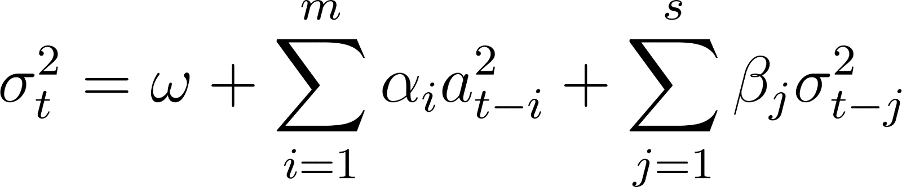
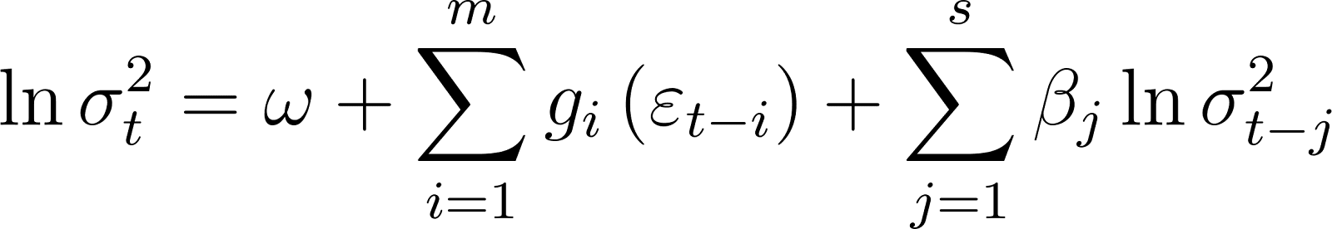
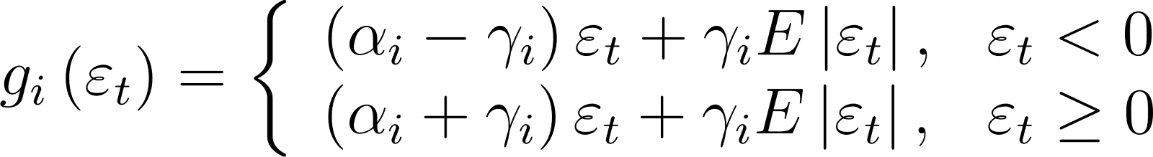
METHODOLOGY
CoVaR
The risk measure ΔCoVaR to estimate downside and upside risk spillovers from crude oil market to stock market
Downside Spillover:
Upside spillover:
ARMA-GARCH Model
GARCH CQR-based UCoVaR model
The ARMA-GARCH model is the most widely used approach to describe the properties of serial correlations, volatility clustering and conditional heteroskedasticity of financial returns.
The downward and upward risk spillover effects are determined by
and

Slide 7
RESEARCH AIM
Our research contributes to the present literature in the following ways:
The research revisited the oil-stock price relationship, employing a CoVaR model based on the GARCH CQR framework in context of emerging markets.
In contrast to prior research, our study uniquely employed a substantial dataset spanning from January 1, 2001, to December 29, 2022, comprising ~5900 daily observations. This approach facilitated the development of a novel and precise framework, capturing intricate market relationships. Notably, our analysis encompassed the post-COVID-19 recession and addressed the challenges and impacts of the Russia-Ukraine conflict on emerging markets.
Analysis of a new dataset encompassing seven developing and emerging nations reveals common characteristics of emerging markets, marked by swift economic growth, transitions from agrarian to industrial economies, openness to foreign investment, and political and regulatory changes for stability. These markets, exemplified by investment in infrastructure and urbanization, also present growth opportunities accompanied by risks such as political instability and currency fluctuations.

Slide 8
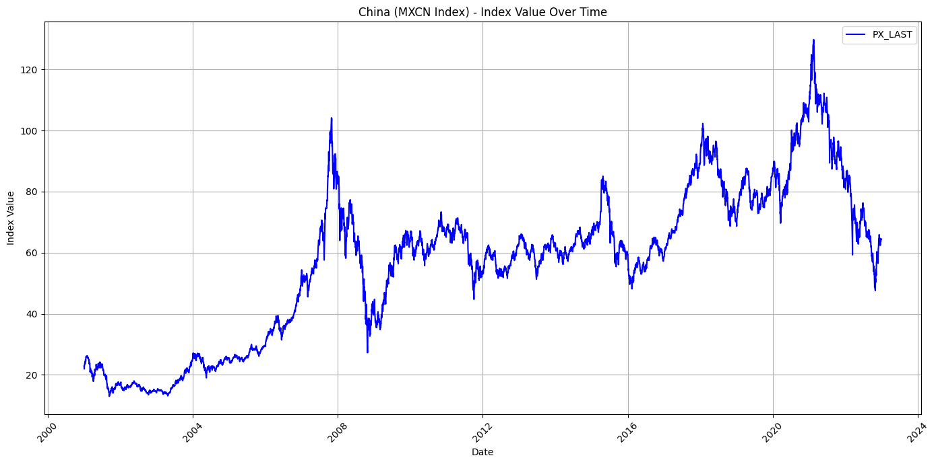
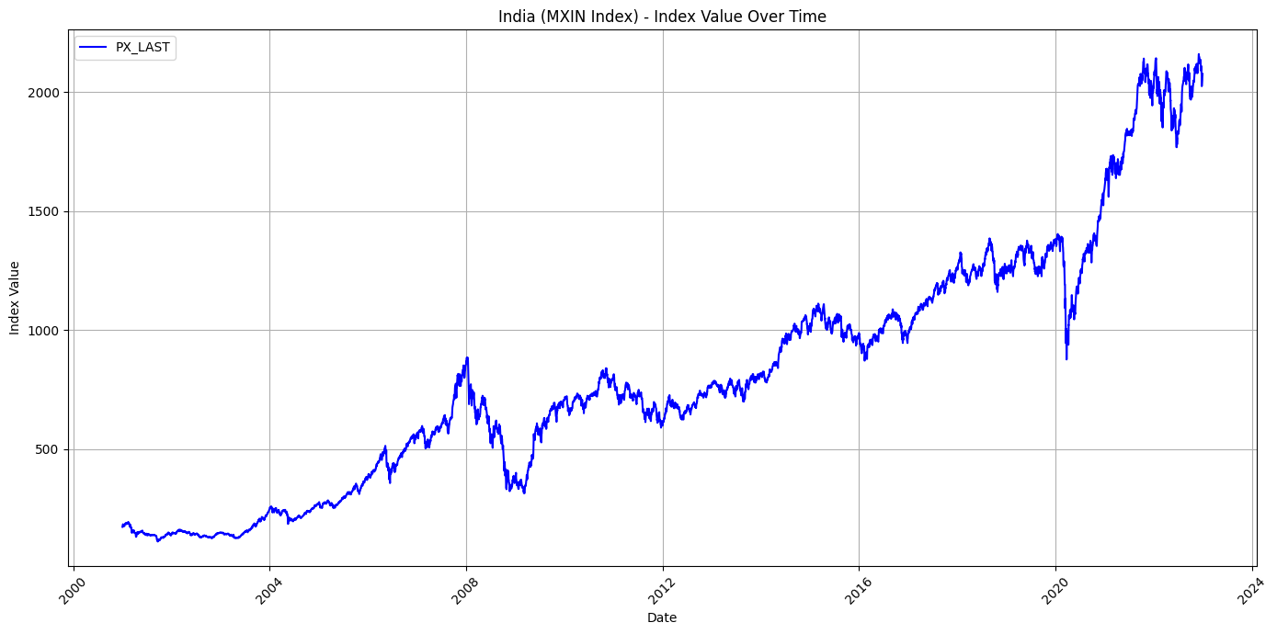
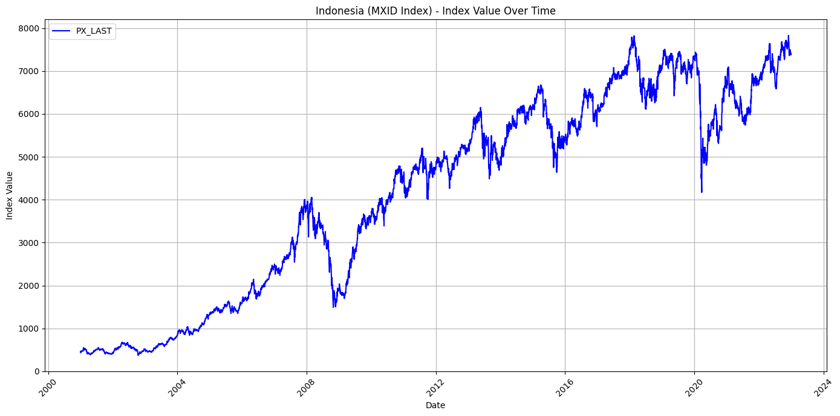
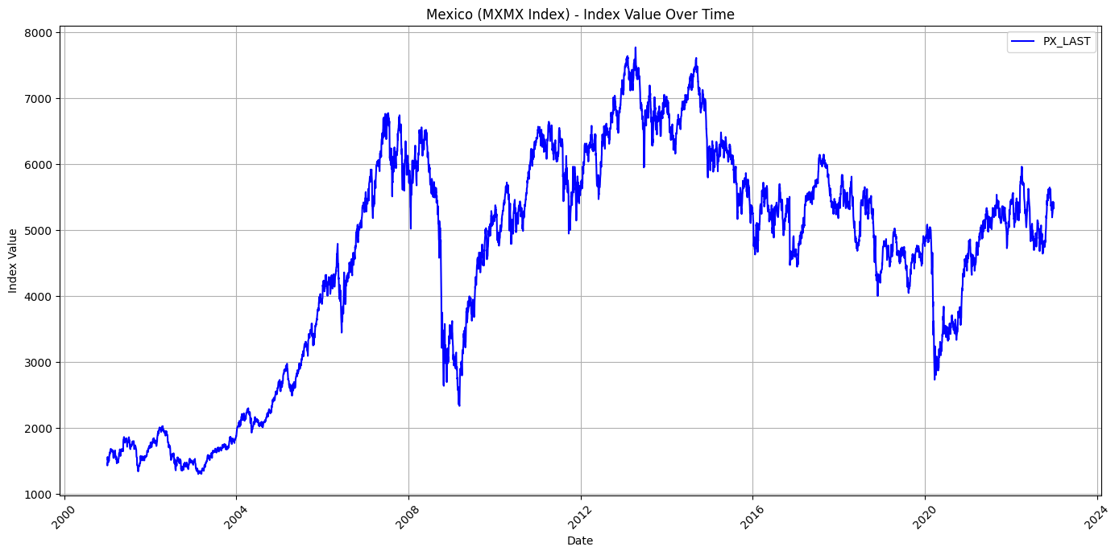
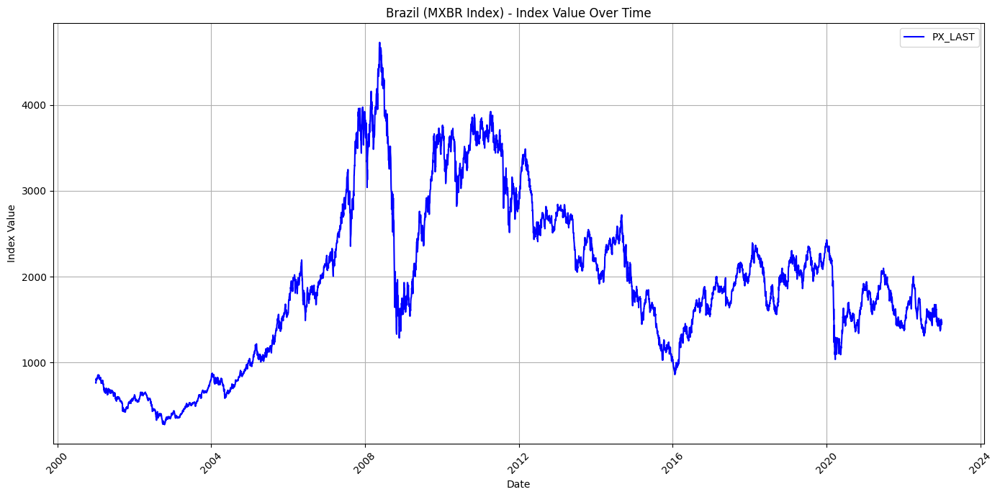
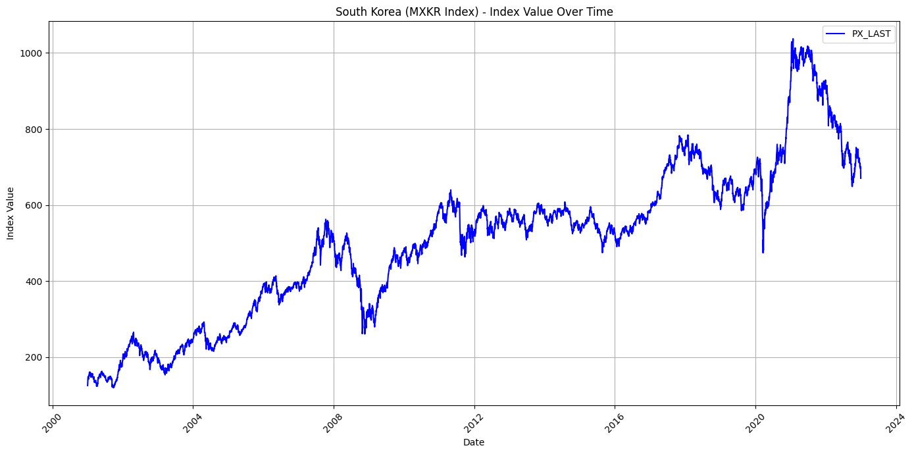
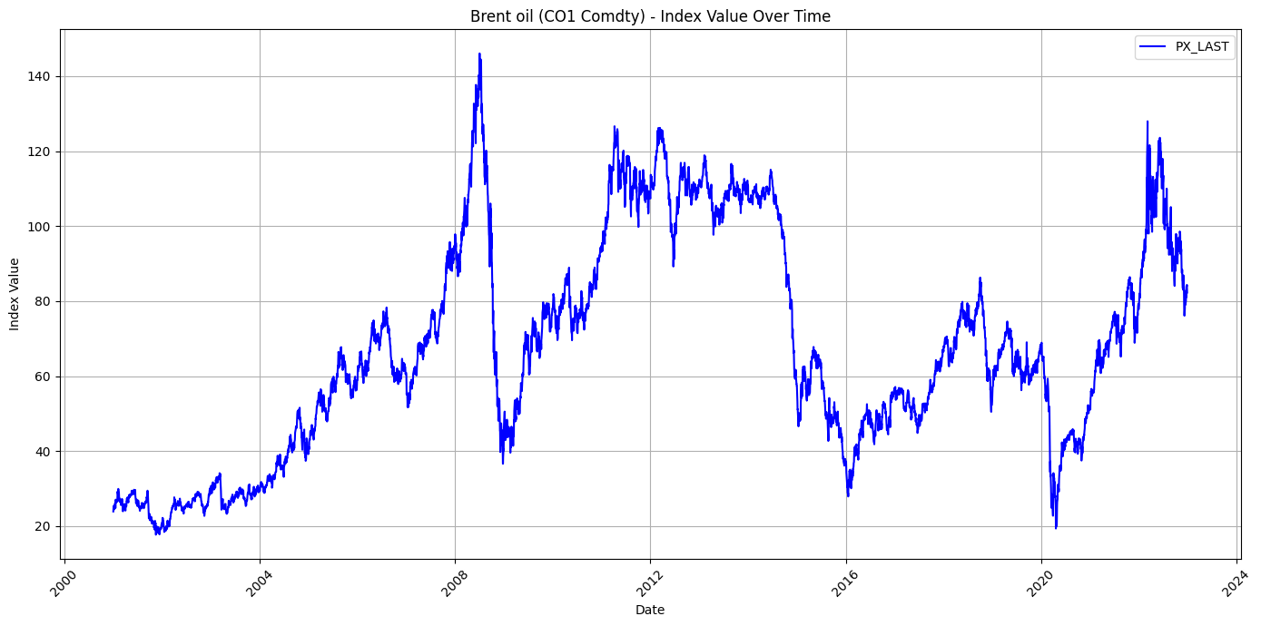
DATA
Examining risk spillovers from the Brent Crude oil market to six nations' stock markets - Brazil, China, India, Indonesia, South Korea and Mexico: we selected daily data of MSCI indices. These were chosen as a representation for the stock market indices–from January 1st 2001 through December 31st 2022 (a total of 5739 observations). In addition to this dataset acquisition—Bloomberg terminal provided us with Brent Crude oil prices' collection
China
India
Indonesia
Mexico
Brazil
South Korea
Brent Oil
Returns Plot
Indonesia Kuwait

Slide 9
 | mean | max | min | median | std | skewness | kurtosis | q05 | q95 | jarque_bera | brent_corr | ljung_box | arch
India | -0.043 | 13.740 | -16.421 | -0.037 | 1.371 | 0.406 | 14.593 | -1.958 | 2.022 | (32292.832438699297, 0.0) | 0.155 | (102.53870667357401, 0.0) | (684.4374237140067, 0.0)
China | -0.018 | 12.838 | -14.059 | 0.000 | 1.686 | 0.033 | 9.491 | -2.486 | 2.676 | (10073.625219250529, 0.0) | 0.158 | (80.25228858689364, 0.0) | (1118.5683839252147, 0.0)
Brazil | -0.011 | 19.434 | -16.619 | -0.059 | 2.217 | 0.468 | 11.344 | -3.131 | 3.450 | (16854.551858621748, 0.0) | 0.305 | (68.44552102932323, 0.0) | (1470.3725793569363, 0.0)
South Korea | -0.029 | 13.091 | -11.722 | 0.000 | 1.424 | 0.279 | 9.455 | -2.118 | 2.283 | (10036.979160916595, 0.0) | 0.133 | (31.230140651633583, 0.052) | (813.6557424618001, 0.0)
Mexico | -0.023 | 11.183 | -15.159 | -0.051 | 1.586 | 0.282 | 9.778 | -2.341 | 2.391 | (11060.192585220986, 0.0) | 0.273 | (96.37611084851379, 0.0) | (1341.1080276692132, 0.0)
Indonesia | -0.049 | 16.261 | -14.444 | 0.000 | 1.565 | 0.304 | 10.775 | -2.354 | 2.393 | (14542.371776422493, 0.0) | 0.121 | (74.05872809103774, 0.0) | (468.8834420147517, 0.0)
Kuwait | -0.005 | 22.711 | -9.199 | 0.000 | 1.231 | 2.266 | 40.868 | -1.654 | 1.715 | (277929.1825517608, 0.0) | 0.086 | (138.27086081030123, 0.0) | (400.76853640040605, 0.0)
Brent oil | -0.022 | 27.976 | -19.077 | -0.070 | 2.305 | 0.633 | 14.534 | -3.421 | 3.585 | (32190.194970732507, 0.0) | 1.000 | (42.97754086819164, 0.002) | (564.7412183573323, 0.0)

Slide 10
RESULTS
Downside Risk Spillover
COUNTRIES | MEAN | STD DEV | RANK
India | -1.55348 | 0.09880 | 1
China | -1.42972 | 0.08924 | 4
Brazil | -1.36715 | 0.24856 | 5
South Korea | -1.43353 | 0.07169 | 3
Mexico | -0.95904 | 0.43837 | 6
Indonesia | -1.44179 | 0.12145 | 2
Upside Risk Spillover
COUNTRIES | MEAN | STD DEV | RANK
India | 1.13630 | 0.37435 | 3
China | 1.42644 | 0.25356 | 1
Brazil | 0.74811 | 0.61404 | 4
South Korea | 1.38498 | 0.25935 | 2
Mexico | 0.69614 | 0.66527 | 5
Indonesia | 1.38335 | 0.25723 | 2

Slide 11
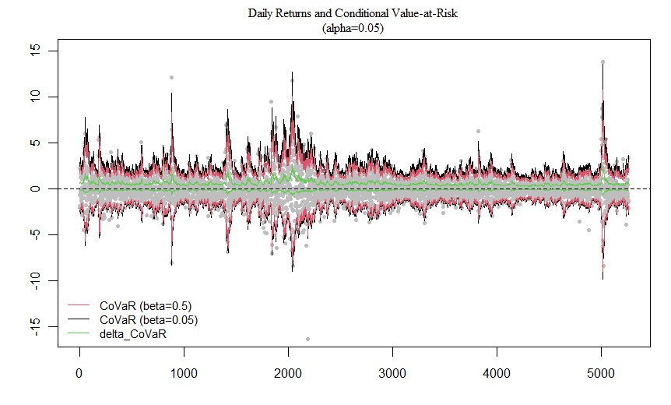
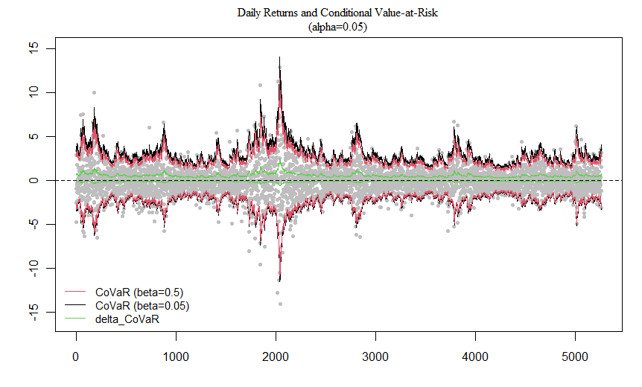
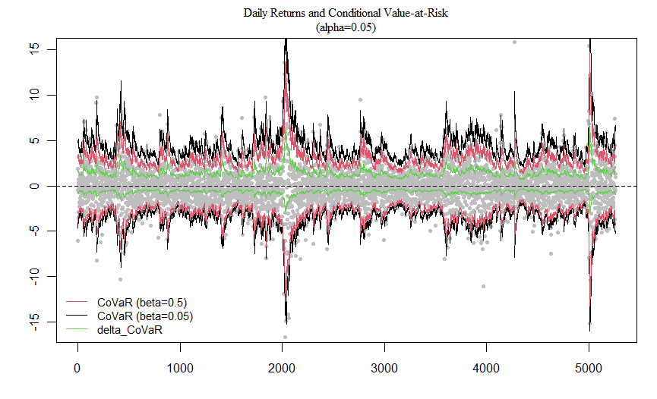
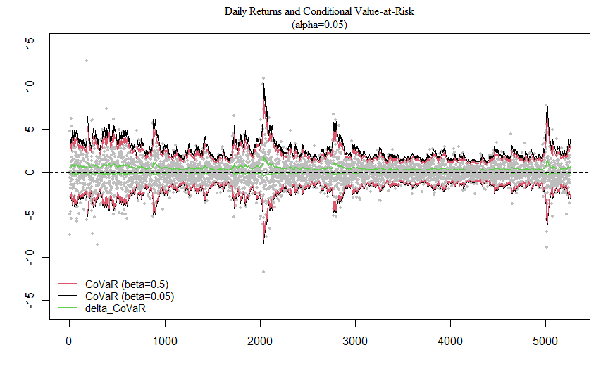
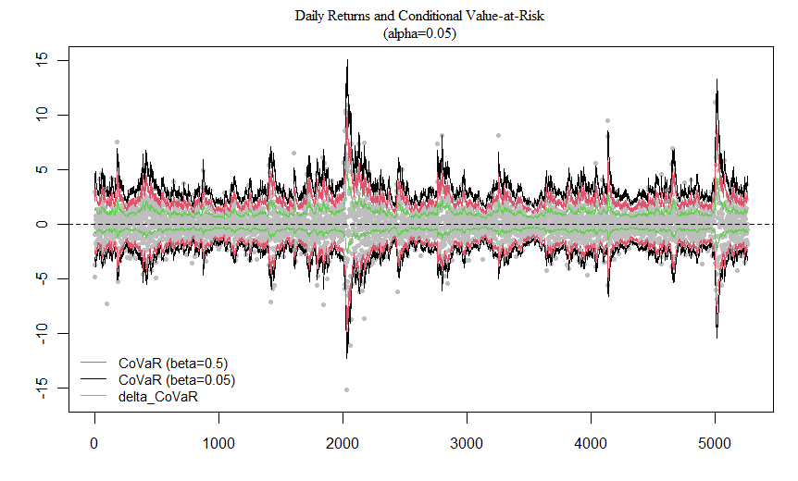
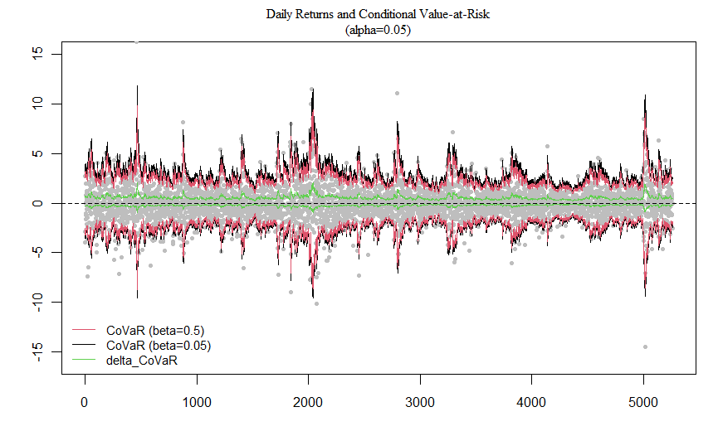
DYNAMIC COVAR AND RISK SPILLOVERS
India
China
Brazil
South Korea
Mexico
Indonesia
Indonesia Kuwait

Slide 12
INFERENCE
The mean absolute value of downside risk is the greatest for India followed by Indonesia at second. The largest downside risk spillover from oil market to the Indian stock market indicates that portfolio managers with long positions could suffer the largest risk over the bearish oil market. This is in continuum with the fact that India and oil are an important relationship. The Mexican stock market is least affected by the bearish oil market, but is very volatile with respect to its downside effect.
The mean absolute value of upside of upside risk is the greatest for China, closely followed by South Korea. The largest upside risk spillover from the oil market to the Chinese stock market indicates that portfolio managers with short positions could suffer the largest risk over the bullish oil market.
Furthermore, oil has the smallest risk spillover effects on the Mexican and Brazilian stock markets for developed and emerging countries, respectively. This indicates that investing in both stock markets is the least risky when oil prices rise or fall sharply.
Oil price displays the largest downside and upside risk spillovers on the Indian and Chinese stock markets for emerging economies. These results imply that the downside and upside risk spillovers are country-specific, and it is necessary for the global investors to utilize this information.
Observing the mean absolute values, it is found that the downside risk spillovers are comparatively more than the upside risk spillovers, which is indicative of the fact that oil is an important commodity for the emerging markets.

Slide 13
CONCLUSION
Oil has been one of the most important commodities across the globe. Its need is of utmost importance to emerging economies. But, the fluctuation in its price has a heavy impact on growing nation and even some of the developed nation. We saw the risk spillover due of this volatility reach the stock indices of the countries affecting firms and companies across different countries.
Political conflicts often are a cause of the commodity disruption. The recent spikes in India, Brazil, Mexico, South Korea and Indonesia are a consequence of the Covid-19 pandemic and the Russia-Ukraine conflict.
A much bigger spike can be seen towards 2008-2010 period caused by the infamous Economic crisis of 2008.
So, estimating the downside and upside risk spillovers from the oil market to the stock markets and accordingly identifying the riskiest stock markets are essential for international capital holders and supervisory authorities.
The dynamic risk spillover effects show heterogeneity over time and are comparatively different for each country.
Finally, based on these findings, we provide important implications for international capital holders and supervisory authorities optimizing the investment portfolios and formulating supervision policy.

Slide 14
POLICY RECOMMENDATIONS
Focus of Supervision: It is necessary for supervisory authorities to regulate the Indonesian, South Korean and Indian stock markets, rather than simply focusing on the supervision of stock markets with higher market capitalization, such as the US stock market.
Regulatory Measures: Sharp changes in oil prices could trigger extreme risk in stock markets. Therefore, financial regulators should closely monitor and effectively contain the impacts of the oil market’s extreme risk. Identifying the ranking of risk spillovers to the stock markets based on dramatic decreases or increases in oil market returns can help regulatory authorities precisely locate the riskiest stock markets.
Risk Management Strategy: To mitigate asset losses from oil market risk spillovers, it’s crucial for fund managers and global investors to thoroughly assess risk contagion measurements and adjust their positions accordingly to optimize portfolio strategy. Greater downside risk spillovers from the oil market to the Indian and Indonesian stock markets suggest that portfolio managers with long positions in these markets could face larger risks during bearish oil market periods. To mitigate this, they should consider closing their long positions or allocating proper instruments to hedge the downside risk spillovers, especially during oil market crises.

Slide 15
THANK YOU

